Slide 1
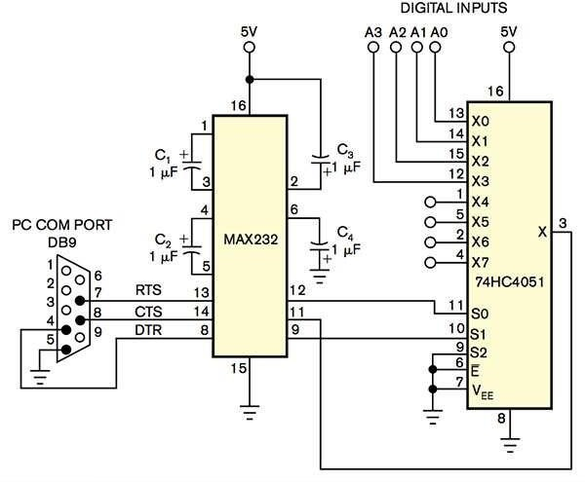
Lecture 2 4CS015: Digital Electronics
Prepared by: Uttam Acharya
1

Slide 2
1. Lecture 2 Coverage
Boolean logic and logic gates
Truth table
Boolean algebra laws
Combinational logic
2

Slide 3
2. Boolean Logic
George Boole (1815-1864)
“An Investigation into the Laws of Thought”
Defined an algebra for solving logical problems
Limited to dealing with facts True or False
Now known as Boolean Algebra
3

Slide 4
3. Basic Logic Definitions
In a Logic System a variable can have one of two possible states.
Single capital letters are used to represent variables.
The bits 1 and 0 are also used as constants.
TRUE | ON | CLOSED | ‘1’ | Yes | 5v
FALSE | OFF | OPEN | ‘0’ | No | 1v
4

Slide 5
4. Logic States
If a switch is closed:
The light will be ON.
This can represent Logic TRUE.
If a switch is open:
The light will be OFF.
This can represent Logic FALSE.
The switch is a Logic variable.
5

Slide 6
5.Boolean Basics: operators
Boole defined three basic operations that could be used with these Boolean variables.
AND
OR
NOT
All logical expressions can be built from these three.
6

Slide 7
5.Boolean Basics: operators
A B
Logical AND
F
A B
Logical OR
F
Logical NOT
A
F
7

Slide 8

5.1 Logical 'AND'
How can we switch the light on?
Switch A
Switch B
Light
Battery
8

Slide 9
5.1 Logical 'AND'
Boolean Expression:
F = A AND B or F= A∙B
Gate Diagram:
A B
F
Truth Table:
Input A | Input B | Output F
0 | 0 | 0
0 | 1 | 0
1 | 0 | 0
1 | 1 | 1
9

Slide 10
5.1.1 The AND relationship.
Boolean representation .
If F,A and B are Boolean variables.
Then the expression F = A∙B means
F is only true when A AND B are both true.
As A is capable of being 1 or 0 and B is capable of being 1 or 0 there are 4 possible states. 00, 01, 10 or 11
10

Slide 11
5.2 Logical 'OR'
How can we switch on the light?
Switch A
Switch B
Light
Battery
11

Slide 12
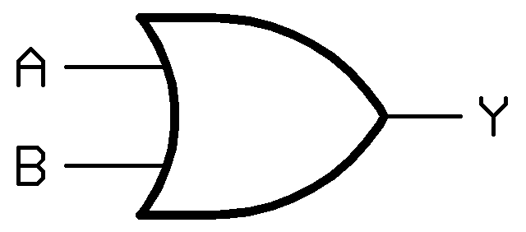
5.2 Logical 'OR'
Boolean Expression:
F = A OR B
Gate Diagram:
alternatively F =A+B
Truth Table:
Input A | Input B | Output F
0 | 0 | 0
0 | 1 | 1
1 | 0 | 1
1 | 1 | 1
13

Slide 13
5.2.1 The OR relationship.
Boolean representation +
If F,A and B are Boolean variables.
Then the expression F = A+B means
F is only true when A OR B, OR both, are true.
As A is capable of being 1 or 0 and B is capable of being 1 or 0 there are 4 possible states. 00, 01, 10 or 11
13

Slide 14

5.3 Logical 'NOT'
How can we switch the light off?
Switch A
Light
Battery
14

Slide 15
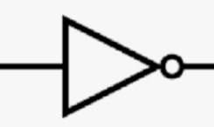

5.3 Logical 'NOT'
oBoolean Expression:
o F = NOT A or F=!A or F=A
oGate Diagram:
A
F
The circle means NOT
oTruth Table:
Input A | Output F
0 | 1
1 | 0
15

Slide 16
5.3.1 Boolean NOT
The NOT relationship reverses the value.
NOT True is False etc…
The Symbol( ) used is usually a bar above the variable or expression to be reversed
E.g if A= true then A = false
In some circumstances we use !
E.g. if B = true !B = false (easier to type)
16

Slide 17
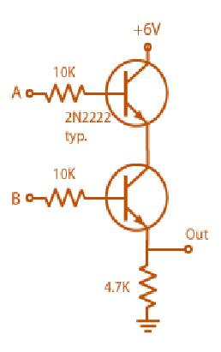
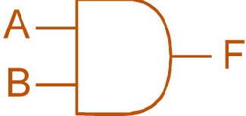


6. Relationship Between Integrated Circuits and Logic Gates
17

Slide 18
7. Other Logic Gates
To make life a little easier the basic logical functions are expanded to include:
NAND.
This is an AND with a NOT output.
NOR.
This is an OR with a NOT output.
XOR.
This is the Exclusive OR function.
18

Slide 19
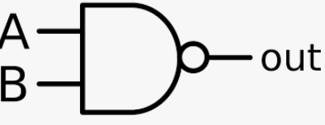
7.1 NAND
Boolean Expression:
F = NOT(A AND B) or F = A∙B
Gate Diagram:
A B
F
o Truth Table:
Input A | Input B | Output F
0 | 0 | 1
0 | 1 | 1
1 | 0 | 1
1 | 1 | 0
19

Slide 20

7.2 NOR
Boolean Expression:
F = NOT(A OR B) or F = A+B
Gate Diagram:
A B
F
Truth Table:
Input A | Input B | Output F
0 | 0 | 1
0 | 1 | 0
1 | 0 | 0
1 | 1 | 0
20

Slide 21
7.3XOR
Boolean Expression:
F = A XOR B or F = A⊕B
Gate Diagram:
A B
F
Truth Table:
Input A | Input B | Output F
0 | 0 | 0
0 | 1 | 1
1 | 0 | 1
1 | 1 | 0
21

Slide 22
8. Boolean Algebra Laws :
The operations +, and ͞ consequently satisfy the basic laws 1, 2 and 3 of Boolean algebra. That is:
1.
A + B ≡ B + A
A ⋅ B ≡ B ⋅ A Commutative Laws
2.
(A + B) + C ≡ A + (B + C)
(A ⋅ B) ⋅ C ≡ A ⋅ (B ⋅ C) Associative Laws
3. A ⋅ (B + C) ≡ (A ⋅ B) + (A ⋅ C)
A + (B ⋅ C) ≡ (A + B) ⋅ (A + C)
Distributive Laws
`
22

Slide 23
8.Another Boolean Algebra (Contd.):
Identity Law Negation Law
A + 0 = A low = high
A . 1 = A ( 0 = 1 )
Idempotent Law
A + A = A
A . A = A
Complement Law
A . A = 0
A + A = 1
Double Negation Law
A = A
Domination Law
A + high = high A . low = low
(A + 1 = 1) A . 0 =0
Absorption Law
A + (A .B) = A
A . (A + B) = A
23

Slide 24
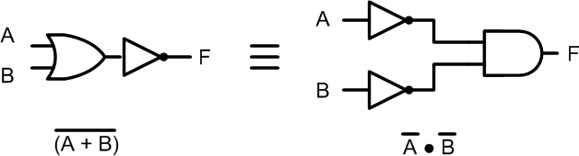

9. DeMorgan’s Law 1
A+B = A .B
24

Slide 25
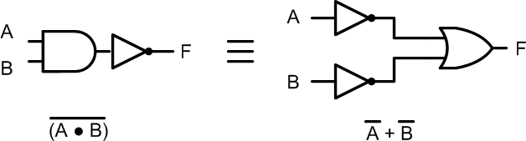
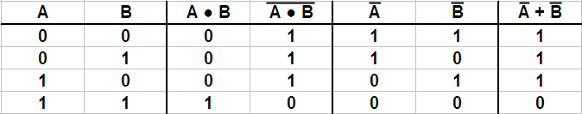
10. DeMorgan’s Law 2
A.B = A+B
25

Slide 26
11. Question1 : NAND and NOR gates are called universal gates, why?
26

Slide 27
12. Precedence of operators
As with normal mathematics when working out the value of a function it is very important to do it in the right order.
NOT AND OR
Parenthesis (brackets) override in the normal way.
When a bar goes above more than 1 symbol it becomes a bracket that reverses.
27

Slide 28
0
0
Where
Example 1. F= A.B.C
Example 2. F= C.A.B
A=1 B=1 C=0 D=1 E=0 G=1
Example 3. F= A+B+C
1
Example 4. F= A.B+C
Example 5. F= A+B.C
1
1
Evaluate these examples
Example 6. F= A+B.C
0
Example 7. F= A .B + (C +A) .D+E+G
1
28

Slide 29
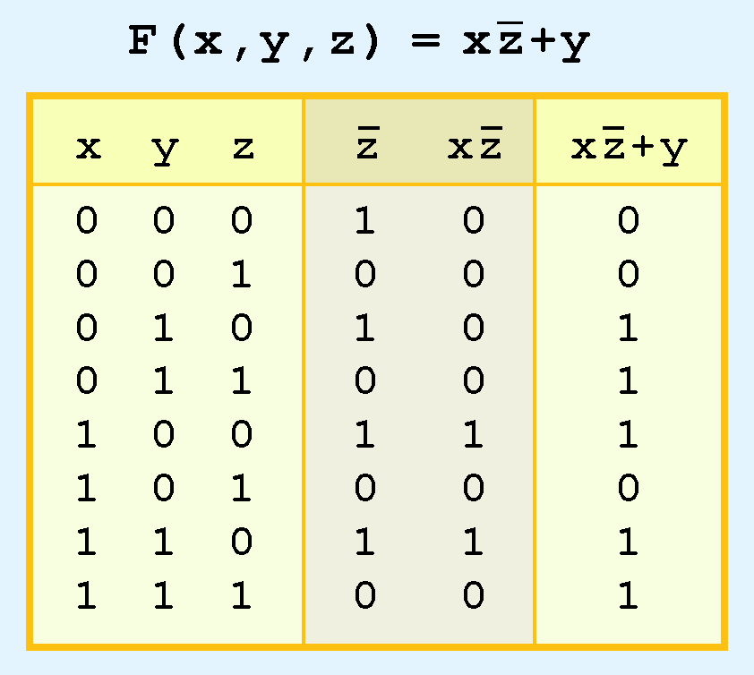
13 Truth table

Slide 30
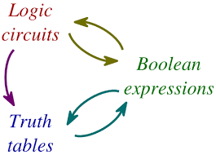
14.Circuit Design:
This circuit uses three gates (two NOT gates and an AND gate)
31

Slide 31

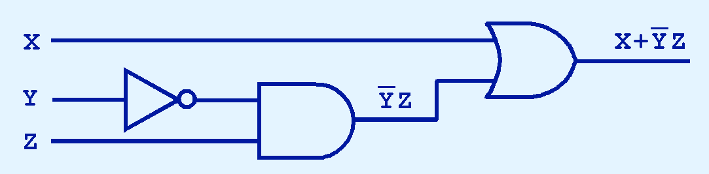
14.1 .Digital component
The main thing to remember is that combinations of gates implement Boolean functions.
The circuit below implements the Boolean function:
We simplify our Boolean expressions so that we can create simpler circuits.
31

Slide 32
14.1 .Digital component​
We have designed a circuit that implements the Boolean function:
This circuit is an example of a combinational logic
circuit.
Combinational logic circuits produce a specified output (almost) at the instant when input values are applied.
In a later section, we will explore circuits where this is not
the case.
32

Slide 33
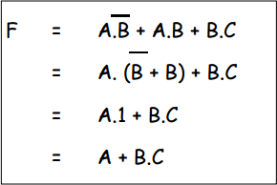
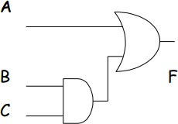
14.2 Simple Combinatorial Logic
(Example 1)
Circuit after Simplification
33

Slide 34
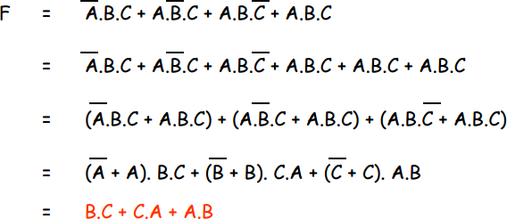
14.3 Example 2:
34

Slide 35
14.4 Example 3:
Simplify:
X = (A.B.C) +(A.B'.C) +(A'.B.C)
35

Slide 36
14.5 Exercises ……
Simplify and construct the logic circuit:
A’.B’ + (A.B)’
(A + B).(A + B) + A.(A + B’)
(A.B’.C’ + A’.B’.C+A.B.C+A’.B.C’)
36

Slide 37
15. Summary
We have looked at the basic logic gates:
Identifying OR, AND, NOT, NAND, NOR and XOR.
We have seen that gates can be joined together to form Combinatorial Logic.
37

Slide 38

38

